Slide 1
Sales Predictions
Using Data Science and Machine learning models

Slide 2
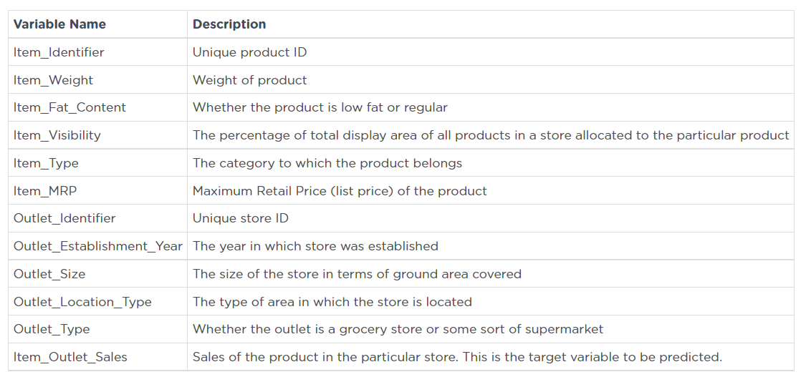
In this project I'm analyzing a dataset and trying to make sales predictions for food items sold at various stores. The goal of this is to help the retailer understand the properties of products and outlets that play crucial roles in increasing sales.
My Project contains data cleaning and analyzing, visualizations of different aspects of data and using machine learning models to see which one is doing better predictions. Data Dictionary for this dataset:

Slide 3
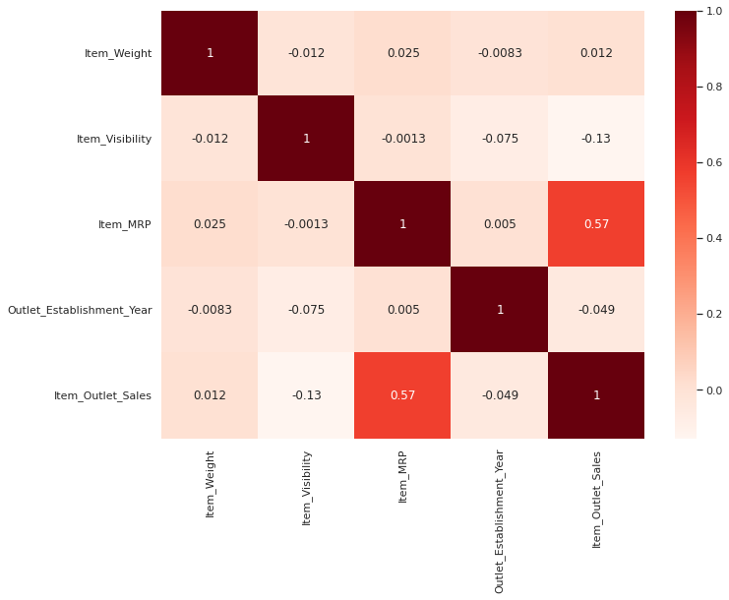
Visualization below shows that Item Max Retail Price has high impact on Outlet Sales

Slide 4
Next slide shows Max Retail Price distribution to have better understanding of it.

Slide 5
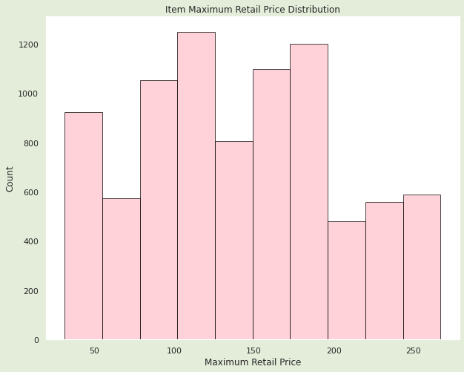
This histogram shows that the most amount of items priced at range of 100 to 125. The least amount is in price range between 200 and 225.

Slide 6
Visualization on the next slide shows which item types are selling the most and the least. That can give an idea, which items the store should try to sell more.

Slide 7
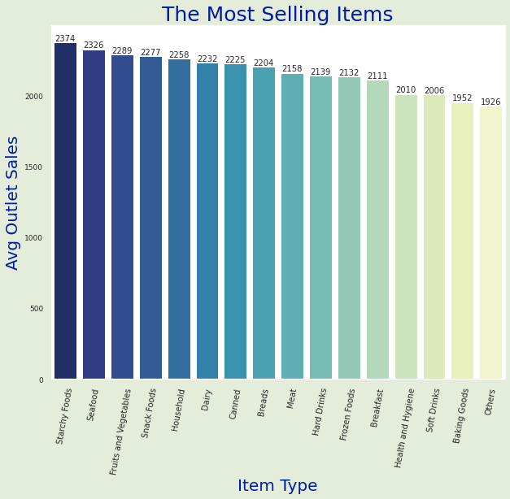
This visualization shows that the most selling items are Starchy Foods, Seafood and Fruits and vegetables. Stores could consider decreasing prices on Baking Goods, Soft Drinks and Health&Hygiene or run some promotions to increase those items sales.

Slide 8
Next visualization shows how outlet size affects sales.

Slide 9
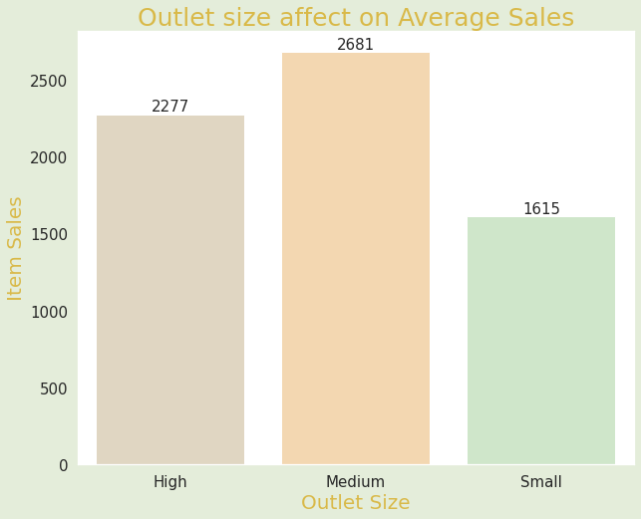
Since sales are the highest at medium size stores, if retailers are considering opening new stores, they should take this into consideration in order to improve sales.

Slide 10
Predictions.
Using different types of Machine Learning models on this data set gives the ability to determine which model does the best job on predictions. Based on my observations using certain model (Random Forest Model with max_depth of 5) could give us the ability to predict about 60% of sales based on all other features we have in data set.

